Slide 1

Thermal analysis of Heat Exchanger- Thermal Systems
Group members:
Alexander Dawes (2206650)
Alex Bates (2009632)
Hugo McNeil (2178127)
Ryan Jeer (2069702)
Notes:
Alex D
In this presentation we will discuss the importance of heat exchangers, introduce the key physics, Perform a CFD study, explain our methodology and interpret our results.

Slide 2
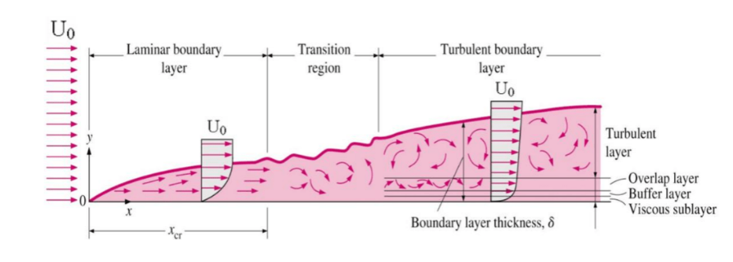
Background and underlying physics
Pipe flow heat exchangers see prevalent use in reactor cooling
Very important to understand the physics behind these exchangers: Fluid flow in a pipe, Transition to turbulence, Convection, Turbulent Boundary layer, fluid properties…..
Physics > Mathematical models > CFD > Design > Real life
Source: https://www.nuclear-power.com/nuclear-engineering/fluid-dynamics/turbulent-flow/turbulent-boundary-layer/
Notes:
Alex D:
Pipe based heat exchangers are commonly used in cooling applications due to their high surface area, ease of implementation, and their suitability for high pressure flows.
It is important to understand the physics behind flow and heat transfer in these devices, so that an accurate mathematical model can be made and guide the design, therefore the real-world process.
A key concept of flow in these devices is that of the turbulent boundary layer. Composed of four sections, the viscous sub-layer, buffer layer, overlap layer and turbulent layer.

Slide 3
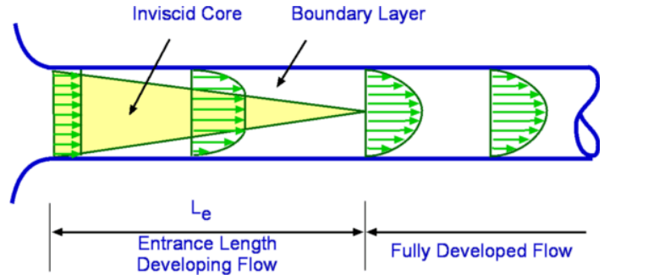
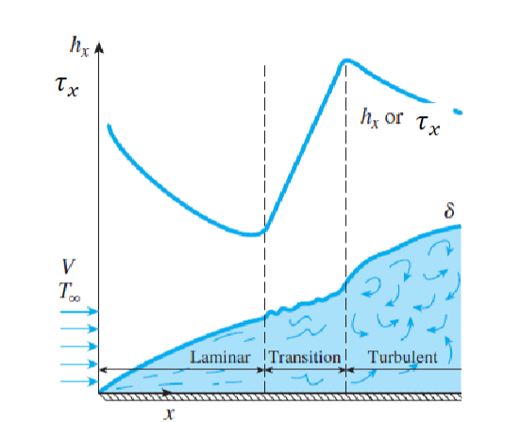
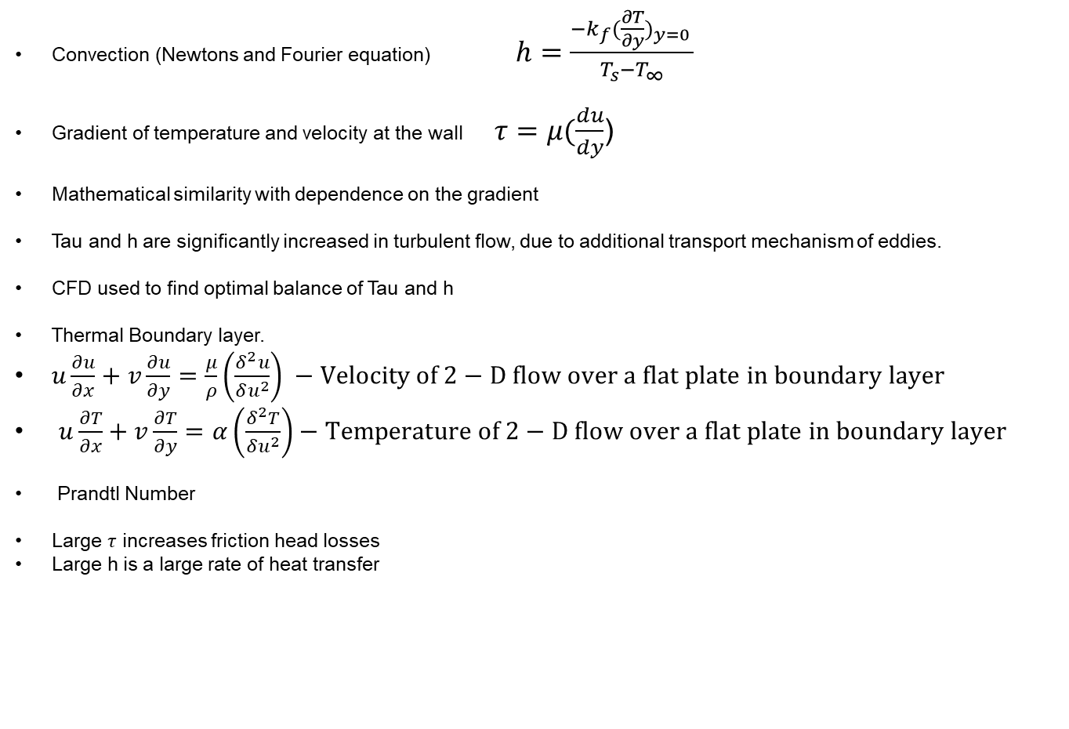
Underlying Physics Continued
Convection (Newtons and Fourier equation) $h=\frac{−k_{f}(\frac{∂T}{∂y})_{y=0} }{T_{s}−T_{∞}}$
Gradient of temperature and velocity at the wall $τ=μ(\frac{du}{dy}$)
Mathematical similarity with dependence on the gradient
Tau and h are significantly increased in turbulent flow, due to additional transport mechanism of eddies.
CFD used to find optimal balance of Tau and h
Thermal Boundary layer.
$u\frac{∂u}{∂x}+v\frac{∂u}{∂y}=\frac{μ}{ρ}\left(\frac{δ^{2}u}{δu^{2}}\right) −Velocity of 2−D flow over a flat plate in boundary layer$
$u\frac{∂T}{∂x}+v\frac{∂T}{∂y}=α\left(\frac{δ^{2}T}{δu^{2}}\right)−Temperature of 2−D flow over a flat plate in boundary layer$
Prandtl Number
Large $τ$ increases friction head losses
Large h is a large rate of heat transfer
Source: http://www.mdp.eng.cam.ac.uk/web/library/enginfo/aerothermal_dvd_only/aero/fprops/pipeflow/node9.html
Source: Lecture notes week 5
Notes:
Alex D
The primary mechanism of heat transfer in pipe flow is convection. Where h represents the convective heat transfer co-efficient.
This can be shown via the combination of newtons convection equation and the Fourier conduction law, to depend linearly on the gradient of temperature at the wall as seen in Eq 1.
This is mathematically similar to the shear stress at the wall (Tau). Which is dependent on the gradient of velocity. Tau can be integrated across the flow surface area to find the frictional losses in the pipe.
The gradient of both velocity and temperature at the wall are non-linear functions of the fluid, flow and the geometry of the system. Hence often require numerical approximation and the use of the aforementioned wall functions.
Tau and h will often follow a similar pattern in pipes as shown in he bottom figure. Initially flow is laminar at the inlet, the laminar boundary layer grows until the boundary layers meet in the middle, at a point referred to as the entrance length where flow is fully developed. Eventually this fully developed flow will transition to turbulent flow, with eddies. Eddies act as an additional mechanism for momentum and heat transfer, hence both tau and h see a significant increase.
It is often the use of CFD to find the design which has a suitable rate of heat transfer, whilst not incurring substantial pressure losses due to friction.
There is also a thermal boundary layer, which behaves in mathematical similarity to the velocity boundary layer. The equations for 2-D flow across a flat plate in the boundary layer showcase this.
The relationship between the thickness of the two layers can be related to the fluid property of the Prandtl number. Which is the ratio of momentum to thermal diffusivity.

Slide 4
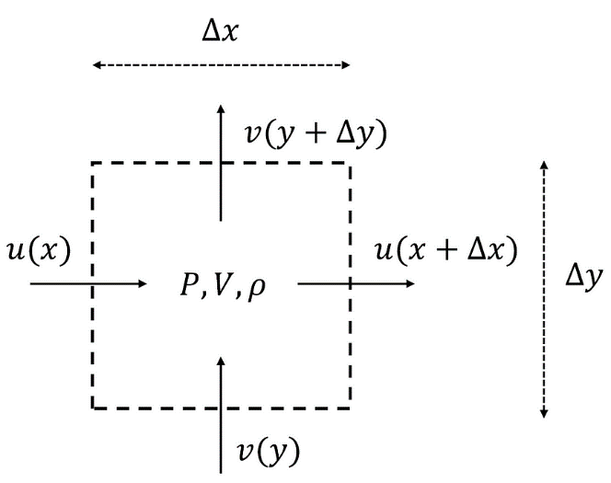
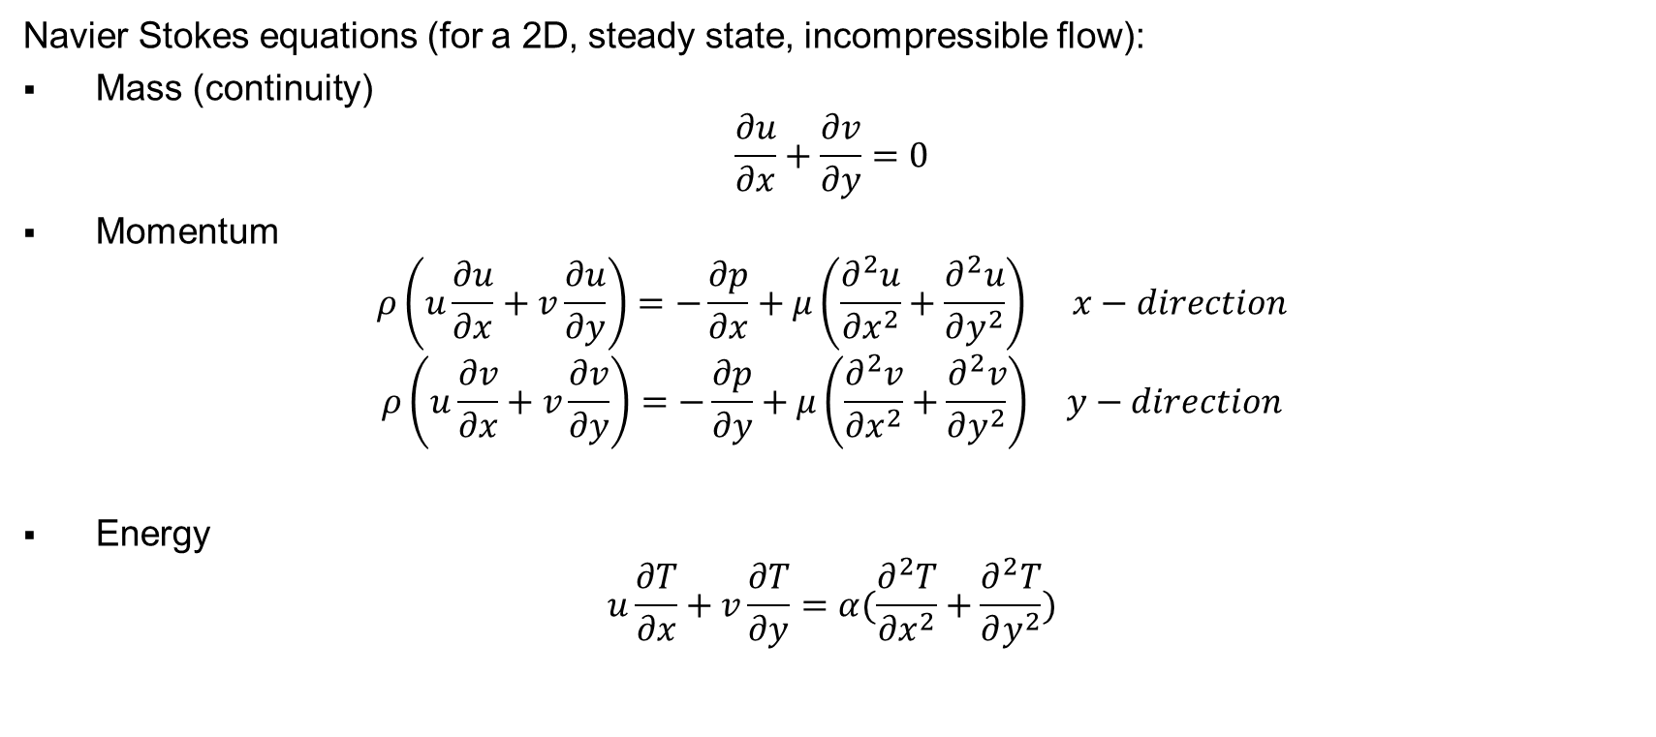
Mathematical modelling – NS equations
Navier Stokes equations (for a 2D, steady state, incompressible flow):
Mass (continuity)
$$\frac{∂u}{∂x}+\frac{∂v}{∂y}=0$$
Momentum
$$ρ\left(u\frac{∂u}{∂x}+v\frac{∂u}{∂y}\right)=−\frac{∂p}{∂x}+μ\left(\frac{∂^{2}u}{∂x^{2}}+\frac{∂^{2}u}{∂y^{2}}\right) x−direction$$
$$ρ\left(u\frac{∂v}{∂x}+v\frac{∂v}{∂y}\right)=−\frac{∂p}{∂y}+μ\left(\frac{∂^{2}v}{∂x^{2}}+\frac{∂^{2}v}{∂y^{2}}\right) y−direction$$
Energy
$$u\frac{∂T}{∂x}+v\frac{∂T}{∂y}=α(\frac{∂^{2}T}{∂x^{2}}+\frac{∂^{2}T}{∂y^{2}})$$
Source: https://towardsdatascience.com/computational-fluid-dynamics-using-python-modeling-laminar-flow-272dad1ebec
Notes:
Ryan
The software works by solving the Navier stokes equations
Which can be seen on the slide for 2D, steady state incompressible flow.
They are derived from the conservation of mass, momentum and energy equations, across a small element.
CFD uses numerical methods to find the solutions of these equations within a given level of convergence

Slide 5
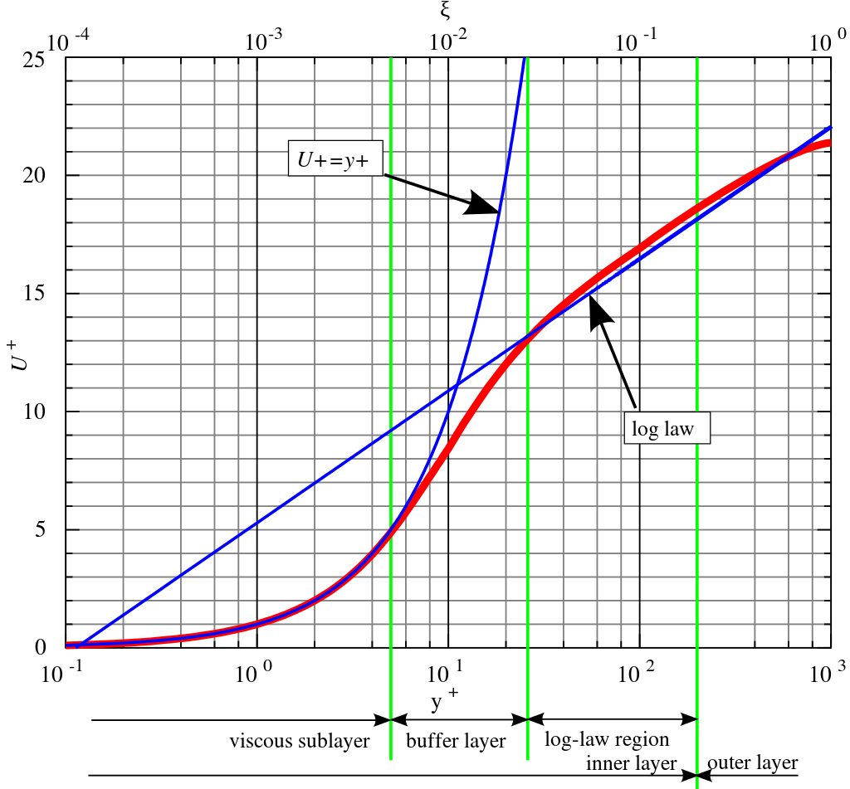

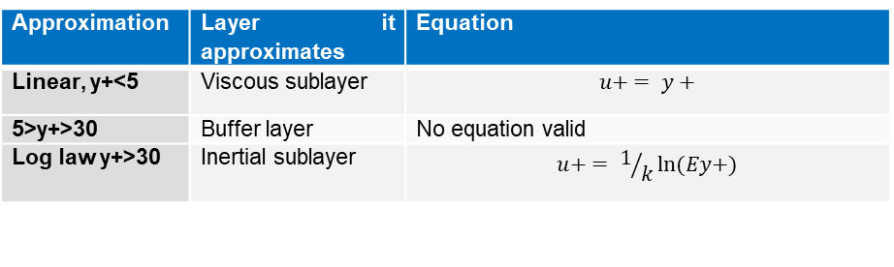
Mathematical modelling – Wall functions
To accurately approximate the function at the wall is very important
As the gradient by the wall effects heat transfer
This is done by wall functions
y+ is a dimensionless distance to the wall
$$y^{+}=\frac{y\sqrt{{τ_{w}}/ρ}}{v}$$
Source: https://en.wikipedia.org/wiki/Law_of_the_wall
Approximation | Layer it approximates | Equation
Linear, y+<5 | Viscous sublayer | $$u+ = y+$$
5>y+>30 | Buffer layer | No equation valid
Log law y+>30 | Inertial sublayer | $$u+ = 1/kln⁡(Ey+)$$
Notes:
Ryan
As mentioned before in CFD,
the behaviour of the boundary layer is approximated using wall functions derived from experimental analysis.
The wall function chosen depends on the value of y+,
a dimensionless distance to the wall, normalised by the friction vector as seen in the slide.
The wall functions can be seen in the table at the bottom of the slide,
where u+ is the dimensionless velocity.
When Y+ is below 5 the wall function is a linear equation
Then, when Y+ is above 30 the wall function is the log law
Between 5 and 30, in the buffer layer, there is no equation to model the boundary layer

Slide 6
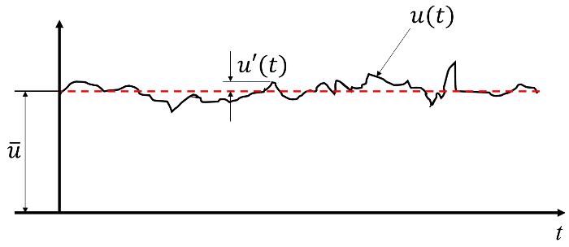
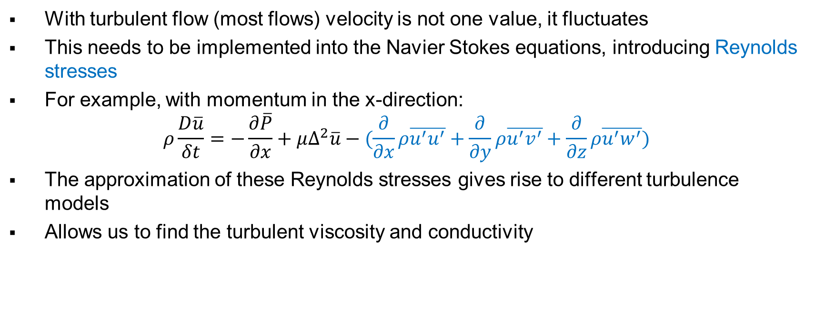
Mathematical modelling - Turbulence
https://www.jove.com/v/10450/measuring-turbulent-flows-using-hot-wire-anemometers
With turbulent flow (most flows) velocity is not one value, it fluctuates
This needs to be implemented into the Navier Stokes equations, introducing Reynolds stresses
For example, with momentum in the x-direction:
$$ρ\frac{D\overline{u}}{δt}=−\frac{∂\overline{P}}{∂x}+μ∆^{2}\overline{u}−(\frac{∂}{∂x}ρ\overline{u^{′}u^{′}}+\frac{∂}{∂y}ρ\overline{u^{′}v^{′}}+\frac{∂}{∂z}ρ\overline{u^{′}w^{′}})$$
The approximation of these Reynolds stresses gives rise to different turbulence models
Allows us to find the turbulent viscosity and conductivity
Notes:
Ryan
In turbulent flow the velocity and other properties fluctuate
They can be described by a mean and fluctuation term
Incorporating this into the Navier Stokes equation makes the Reynolds Averaged Navier Stokes equations
This introduces Reynolds stresses,
which can be seen in blue
The approximations and equations for these Reynolds stresses leads to different turbulence models
Which allow us to find the turbulent viscosity and conductivity

Slide 7
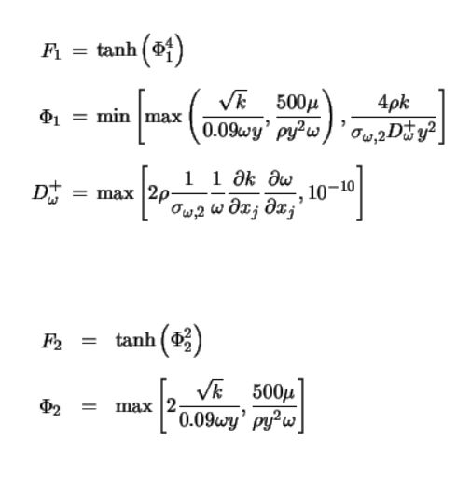
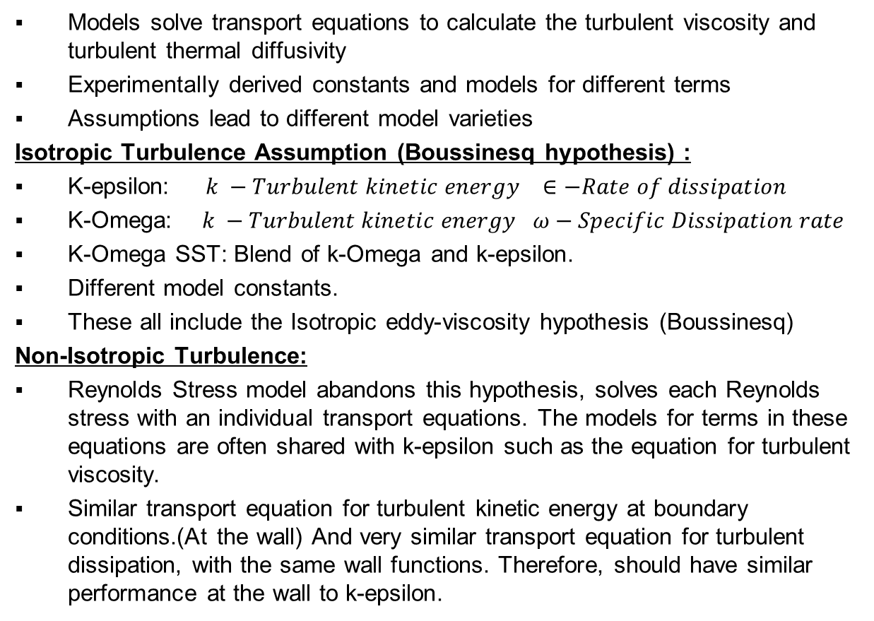
Mathematical modelling of Turbulence
Models solve transport equations to calculate the turbulent viscosity and turbulent thermal diffusivity
Experimentally derived constants and models for different terms
Assumptions lead to different model varieties
Isotropic Turbulence Assumption (Boussinesq hypothesis) :
K-epsilon: $k −Turbulent kinetic energy ∈−Rate of dissipation$
K-Omega: $k −Turbulent kinetic energy ω−Specific Dissipation rate$
K-Omega SST: Blend of k-Omega and k-epsilon.
Different model constants.
These all include the Isotropic eddy-viscosity hypothesis (Boussinesq)
Non-Isotropic Turbulence:
Reynolds Stress model abandons this hypothesis, solves each Reynolds stress with an individual transport equations. The models for terms in these equations are often shared with k-epsilon such as the equation for turbulent viscosity.
Similar transport equation for turbulent kinetic energy at boundary conditions.(At the wall) And very similar transport equation for turbulent dissipation, with the same wall functions. Therefore, should have similar performance at the wall to k-epsilon.
ANSYS FLUENT K-Omega SST Blending Function:
Source: Ansys Theory Guide
https://www.afs.enea.it/project/neptunius/docs/fluent/html/th/node42.htm
Notes:
Alex D
To find these terms to close the RANS, there are different models based on solving additional transport equations.
The primary hypothesis behind the simplest 2-equation models is that the Reynolds stresses are proportional to the gradient of mean velocity. This simplifies the Reynolds stress tensor so that only two transport equations are needed.
The primary 2 equation model is the k-epsilon model. Which solves for turbulent viscosity via evaluating turbulent kinetic energy and its rate of dissipation.
It is only valid for high turbulent flow in its standard form.
K-Omega is a similar model that is based on the specific rate of dissipation. It has been shown to have a better effect in the near wall regions of flow but is sensitive to the conditions in the free stream. K-omega also includes low Reynolds number correction.
These Models rely on experimentally derived constants which can affect the result of the model and account for differences.
K-Omega SST can be thought of as a blend of k-omega and k-epsilon. K-omega in the near wall region. K-epsilon away from the wall in the bulk flow. The blending function used by ANSYS FLUENT can be seen in the figure.
The Reynolds stress model abandons the isotropic turbulence hypothesis. This makes it more suitable for swirling flows.
It solves a transport equation for each Reynolds stress term. Introduces significant computational complexity.
Reynolds stress has more complex transport equations that require models such as turbulent diffusion and pressure-strain.
RS often shares some models for terms in the transport equation with k-epsilon.
Notably, it uses a very similar transport equation for turbulent kinetic energy at the wall boundary condition, with identical wall functions for turbulent dissipation. Therefore, assuming the Boussinesq hypothesis is valid in a given flow. RS and k-epsilon should show good agreement at the wall.

Slide 8
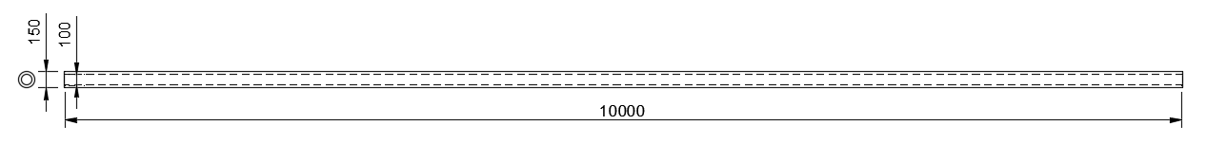
Settings - General
Adiabatic Outer wall
Outlet
Inlet
Heated inner wall
2D axisymmetric model
Offset 50 mm in y-direction
Pressure based solver
Energy equation on
Nitrogen tested with both constant and varying results
Resolved with SIMPLE algorithm
Second order coupling to discretize variables
Gravity ignored
Notes:
Ryan
CFD was done with ANSYS FLUENT
This is the set up of the simulations
A 2D axis-symetric model was used to reduce computational demand, due to the symmetry of the system
a pressure based Steady state solver was used
Energy equation was turned on to allow for heating of the fluid
Variables solved with SIMPLE algorithm
With Second order coupling scheme to discretize the variables
Gravity was ignored as its affects were found to be negligible

Slide 9
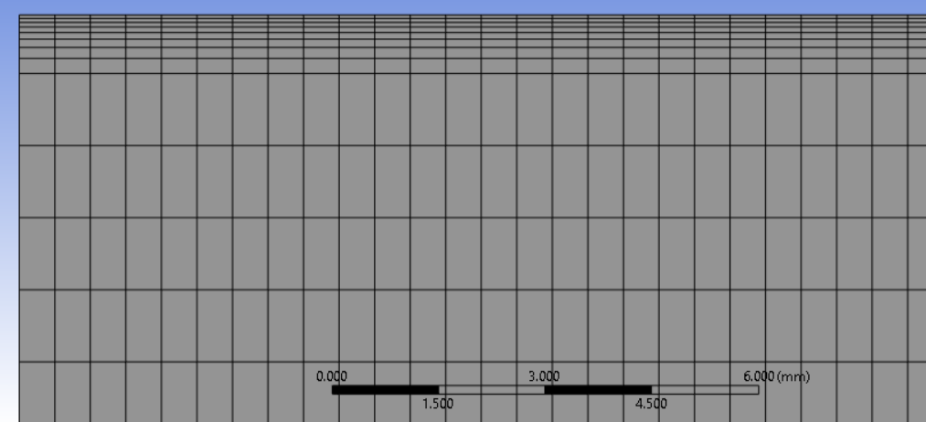
Settings – Boundary Conditions
Boundary conditions can be seen below
Inflation needed to push the y+ below 5 for high mass flow rate 0.5 kg/s
First layer thickness 0.05 mm
8 layers
Growth rate 1.2
Wall | Type | Reasoning
Inlet | Mass-flow inlet | Mass flow rate varies in problem
Outlet | Mass-flow outlet | To simplify the calculations set to the same as the inlet. Conservation of mass means that the inlet and outlet will have the same mass flow rate
Inner wall | Stationary, no slip wall with a 20,000 W/m² heat flux | This wall is heated with a uniform 20 kW/m² heat flux, from some chemical reaction
Outer wall | Stationary, no slip adiabatic wall | The outer wall is adiabatic
Notes:
Ryan
These are the boundary conditions we used
Inlet was a mass flow inlet
Outlet was also set to mass flow to simplify the calculations the software does
Inner wall had a 20 kW/m^squared heat flux
Outer wall was set to adiabatic
In order to have y+ less than 5 for high mass flow rates
We needed 8 layers of inflation
With a growth rate of 1.2
And a first layer thickness of 0.05 mm

Slide 10
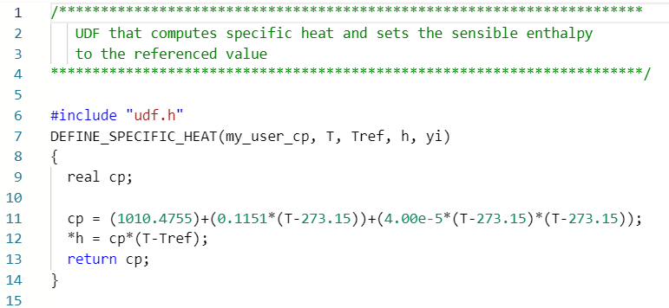
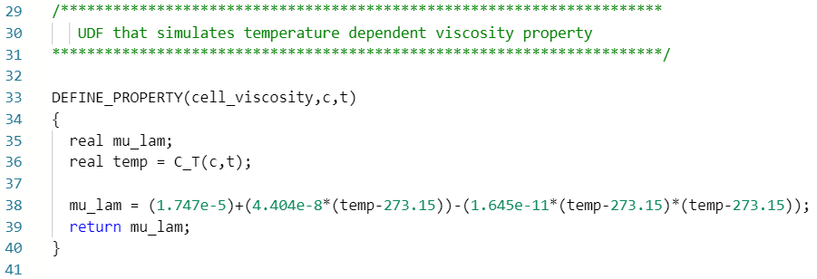
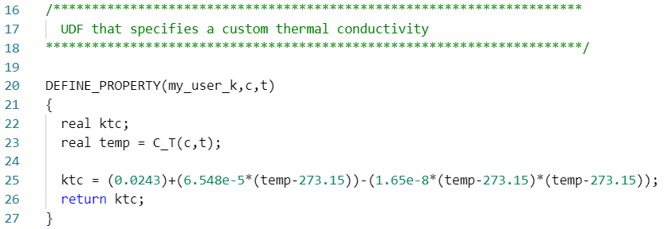
Settings – User Defined Function
Nitrogen as a function with UDF
Used in each cell, every iteration
Notes:
Ryan
These are the user defined functions used to model nitrogen as a function
The solver uses them to give each cell its temperature dependent properties
This was done for
Specific heat
Thermal conductivity
And viscosity

Slide 11
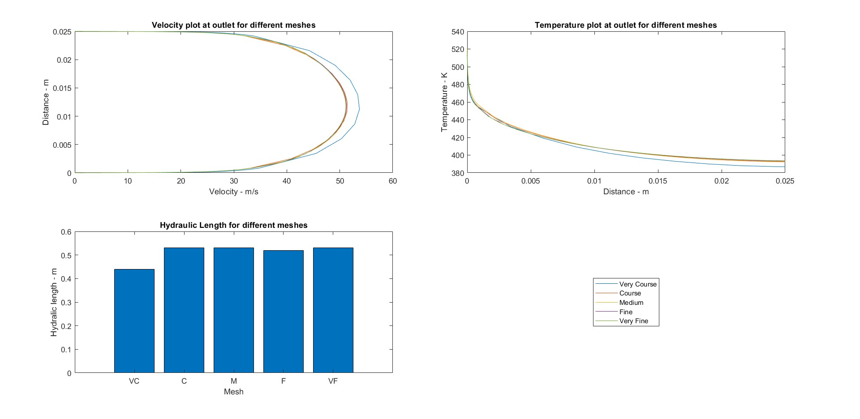
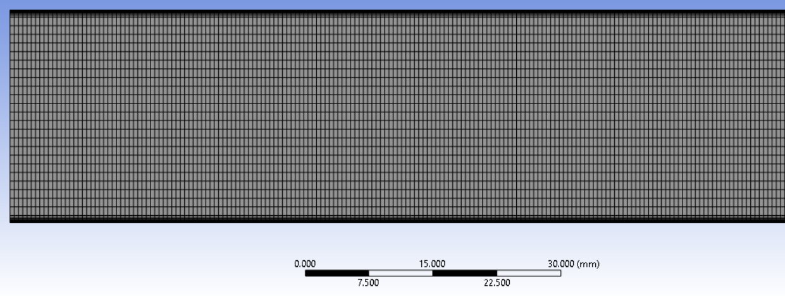
Results – Mesh Dependence study
Coarse had limited resolution
Medium mesh shows acceptable values
However, struggles with convergence
Therefore, the fine mesh was chosen
Mesh | Very Course | Course | Medium | Fine | Very Fine
Bulk mesh | 10 x 20,000 | 15 x 20,000 | 20 x 20,000 | 25 x 20,000 | 30 x 20,000
Total cells | 500,000 | 600,000 | 700,000 | 780,000 | 880,000
Notes:
Ryan
The mesh dependence study was done with a k-epsilon turbulence model with constant nitrogen properties
The MESHES tested can be seen at the bottom
As mentioned we needed inflation to have y+ less than 5 for all mass flow rates
Therefore, we needed a lot of elements so that the max aspect ratio was less than 5 in bulk flow,
and less than 10 in the inflation layer
From the course MESH the hydraulic length appears to converge
But the course MESH had a limited resolution when plotted, which would hinder later analysis,
The medium mesh showed very close matches with velocity and temperature distribution at the outlet
But struggles to converge,
with the residuals oscillating
So the fine MESH was chosen
A section of The fine mesh can be seen in the bottom right picture

Slide 12
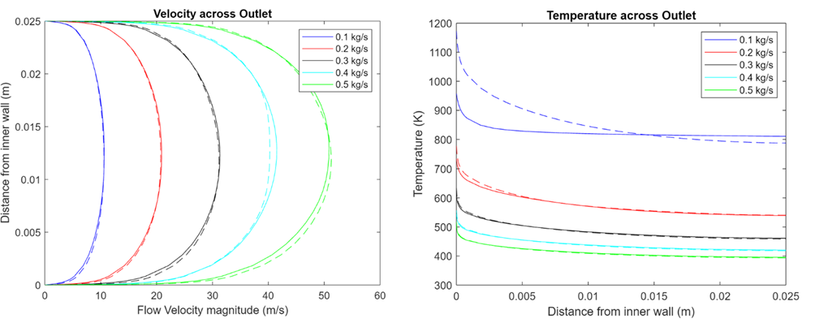
Velocity results
Increasing flow rate led to increasing velocity across the board
Additionally lead to increased variation between constant and variable fluid properties
Velocity and temperature profiles across the outlet. Solid lines represent constant physical properties and dashed lines represent temperature dependent physical properties
Notes:
Alex B
Following on from the mesh dependence study, multiple simulations for all 5 flow rates were carried out for both constant properties and temperature dependant properties of which it was found that when Increasing the flow rate, this led not only to a general increase in velocity across the board but also increasing the variation between the constant and physical properties evaluated. This is potentially due to the different materials models having different numerical instability and thus varied distributions are reaches. This is supported by the inconsistency in pattern of the variation which is exaggerated at higher flow rates.

Slide 13
Temperature results
As flow rate increased, average temperature and temperature difference across the flow decreased
Temperature dependent fluid properties saw higher initial outer wall temperatures across the board
Modelling low flow rates should utilise temperature varying material properties
temperature profiles across the outlet. Solid lines represent constant physical properties and dashed lines represent temperature dependent physical properties
Notes:
Alex B
As the flow rate increases, the average temperature and temperature difference decrease directly as a result. There were some discrepancies between material models noticeably occurring at the slower flow rates which showed much larger temperature variation due to the fluid having more time to heat up and thus have its properties altered whereas at higher flow rates, there is more convective cooling and ess time for fluid to be heated and so the simpler model would suffice in predicting results.

Slide 14
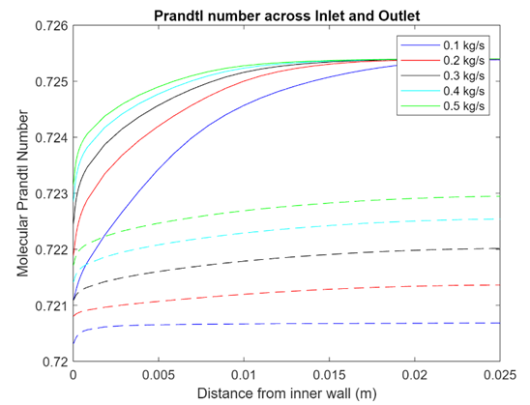
Prandtl number results
Prandtl number distributions coincide to temperature distribution across the walls
Lower mass flow rates have less variation at the outlet
Steeper Prandtl number transition at the inlet for all flow rates
Sharp Prandtl number detected at the wall
Prandtl number distribution. Solid lines showing inlet and dashed lines showing outlet values.(When Constant material properties were used a Prandtl number of 0.715138 was achieved at all points in the flow
Notes:
Prandtl Number distributions for the different turbulence models across Inlet, 5 m length and outlet respectively in vertically descending order

Slide 15
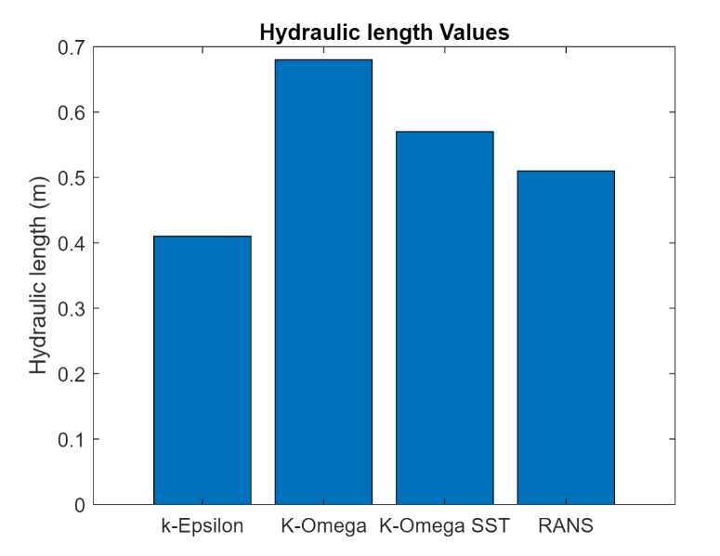
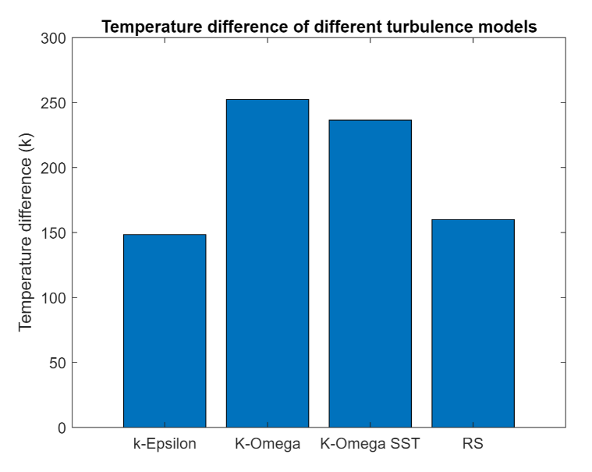
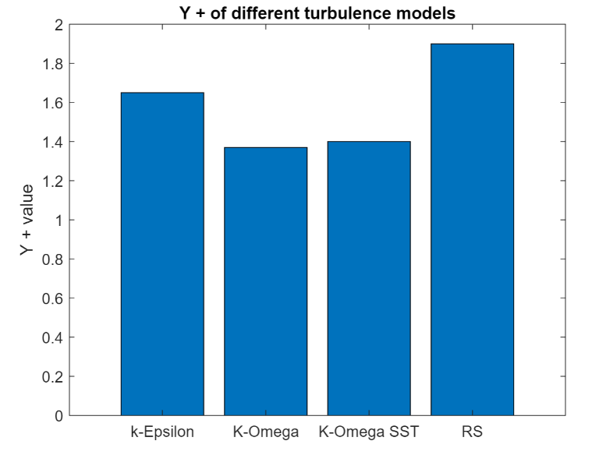
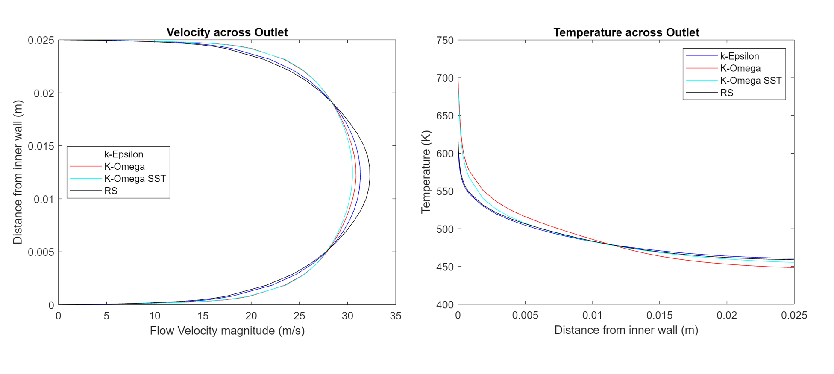
Turbulence Study Results
Notes:
Alex D
For the turbulence investigation, a flowrate of 0.3 kg/s was chosen, and our user defined functions were specified for the fluid.
The turbulence model changes the steady state solution of both the temperature and velocity across the outlet. Reynolds stress demonstrates the highest peak velocity, and k-Omega the highest peak temperature. The Hydraulic length also changes with the different turbulence models, with the boundary layer growth taking the longest for k-omega and k-omega SST.
The lower y+in the k-omega based models is due to the different transport equations used in these models and highlights the improved wall treatment.
However, SST tends to the k-epsilon and RS curves in the bulk flow for all metrics and this is due to it being a stronger blend of k-epsilon in the bulk flow away from the wall.
Overall, k-epsilon and RS show good agreement due to several shared equations, whereas k-omega and k-omega SST differ, especially in the temperature difference across the walls at the outlet. Where there is almost a 100K difference. This could be due to the models predicting a smaller degree of turbulence, which decreases the rate of heat transfer compared to the other models. And leads to higher peak and difference values.
The majority of the temperature difference between the models occurs near the wall, with bulk flow distributions remaining similar. Hence, it can be seen that the largest differences between the models occur due to the different wall treatments.
Overall, there is no benefit of the computational cost of RS compared to k-epsilon in this flow, but further experimental validation, especially at the wall region, should be obtained to identify which of k-epsilon, k-omega, and k-omega SST is the most suitable for further analysis.

Slide 16
Conclusions
Optimal mesh had 25 x 20,000 elements in the bulk flow with inflation at the walls
Increasing the flow rate resulted in lower peak and average temperatures
Changing fluid properties from constant to temperature dependent is valuable for low flow rate models
Turbulence model changes behavior of the boundary layer
Investigate different pipe geometries and methods of inducing turbulence.

Slide 17
Thank you for listening
Alexander Dawes- Background and underlying Physics, Modelling of Turbulence, Turbulence investigation results and discussion.
Alex Bates – Results and Discussion, Modelling of flow rates 0.4 & 0.5 kg/s for both constant and temperature dependant properties
Hugo – Results and Discussion, Modelling of flow rates for 0.1 & 0.2 kg/s for constant and temperature dependant properties
Ryan Jeer – Methods and settings, set up of CFD, UDF for nitrogen as a function, set up models for constant and temperature dependant properties with 0.3 kg/s, mesh dependence results and discussion

